Slide 1

SPEED TYPING
Engineering Exploration Project Seminar on
ASHRITHA REDDY.M 1601-20-733-066
NIVEDITHA REDDY.M 1601-20-733-074
SHRUTHI KUNCHAKURI 1601-20-733-080
ASHISH GOLLA 1601-20-733-094
SAI HEMANTH S 1601-20-733-108
Core branch: Computer Science and Engineering (CSE – 2)
Mentor : Durga Devi
Designation :

Slide 2

CONTENTS
Motivation
Problem Statement
Formulation
Results & Discussion
Summary
Future scope
References

Slide 3
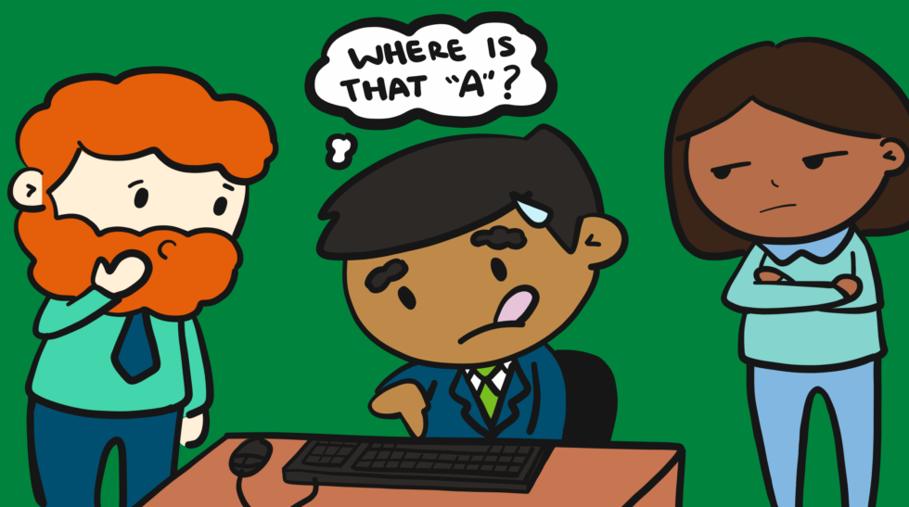
MOTIVATION
Typing is a fundamental skill, and it is still one of the most important computer skills you can learn.
Learning to type fast and accurately will help you in many ways in life, and it should be considered an essential skill for anyone who sees themselves working with a computer in some capacity
In this pandemic situation most of the people are doing work from home
and are engaged with more work and are spending more time with computers
Speed typing plays a major role in completing their work faster and be more productive.
The productivity of a business depends on how things are done faster. To complete your work faster it is important to develop typing skills.
Typing helps you to work comfortably on the computer, it aids in communicating with colleagues and customers, creating documents, and finding new information.

Slide 4
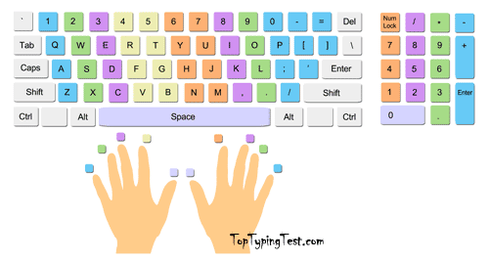
PROBLEM STATEMENT
Most of the people spend a lot of time on their computers due to heavy work and due to lack of speed typing the duration of their work time increases which in turn shows an effect on their health.
And this project helps in
Improving your typing accuracy and speed through which you can save a lot of time and be more productive
Testing your wpm (word per minute) speed and accuracy.
It is a simple, most straightforward, and an easy way to learn touch for people of all ages.
Enhancing your overall computer skills.
Analyzing and trains your skills.

Slide 5
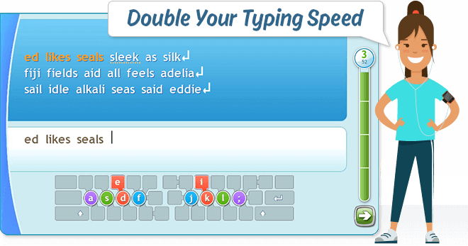
FORMULATION
The modules which are needed to be imported are tkinter,pyttsx3,random
The file test.txt stores Welcome
The file highscore.txt stores the highest score
The file words.py contains all the lines which are displayed to the user
The file tips.pptx contains the tips to improve typing speed
The user can access the tips by clicking on tips button
A method lev is created which displays a window to choose the levels
A method level1 is created for level 1 which calculates wpm,speed and accuracy for which the sentences are picked up randomly from the words1 list in words.py file
Calculations involved are:
accuracy=(count*100)/len(words1[word1])
wpm=len(answer)/4
wpm=int(wpm/(time_taken/60))
time_taken=end-start

Slide 6
FORMULATION
The accuracy and wpm scored by the user are stored in a file named score1.txt and which are validated for level 2
The user can enter into level 2 if and only if he scores 100% accuracy and wpm of >=25
A method level2 is created for level 2 which calculates wpm,speed and accuracy for which the sentences are picked up randomly from the words2 list in words.py file
Calculations involved are:
accuracy=(count*100)/len(words2[word2])
wpm=len(answer)/4
wpm=int(wpm/(time_taken/60))
time_taken=end-start
The accuracy and wpm scored by the user are stored in a file named score2.txt and which are validated for level 3
The user can enter into level 3 if and only if he scores 100% accuracy and wpm of >=50

Slide 7
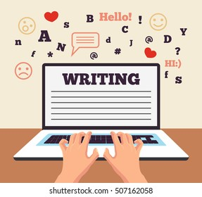
FORMULATION
A method level3 is created for level 3 which calculates wpm,speed and accuracy for which the sentences are picked up randomly from the words3 list in words.py file
Calculations involved are:
accuracy=(count*100)/len(words3[word3])
wpm=len(answer)/4
wpm=int(wpm/(time_taken/60))
time_taken=end-start
After completing every level, a result window is displayed which shows
the details of the wrong characters typed , the accuracy and wpm scored
by the user and gives an information about whether the user is
eligible for next level or not.

Slide 8
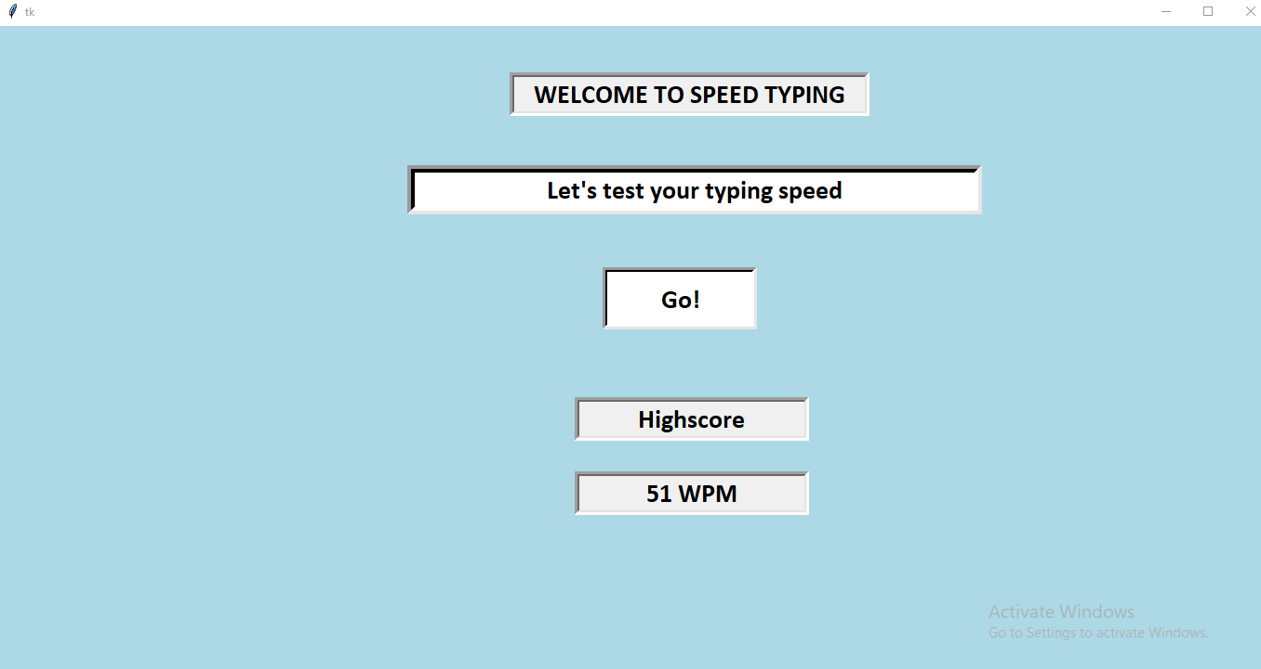
RESULTS&DISCUSSIONS
MAIN SCREEN

Slide 9
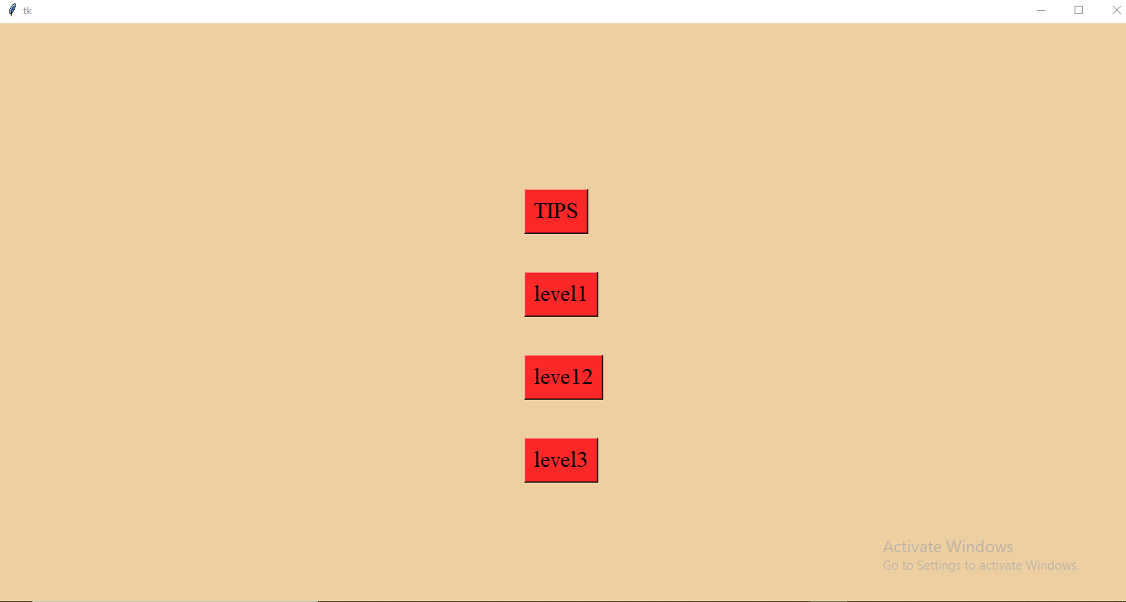
RESULTS&DISCUSSIONS(CONTD…)
LEVELS WINDOW
10

Slide 10
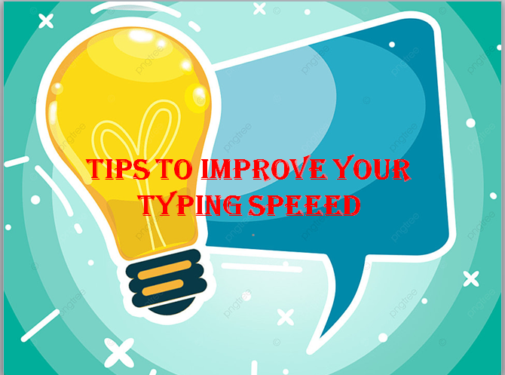
RESULTS&DISCUSSIONS(CONTD…)
TIPS
10

Slide 11
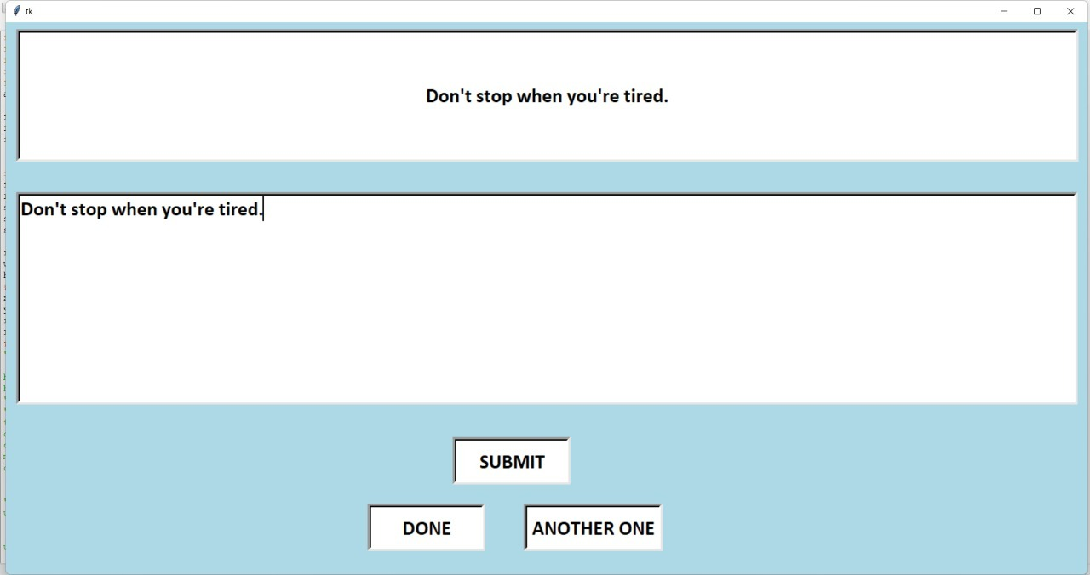
RESULTS&DISCUSSIONS(CONTD…)
LEVEL-1 WINDOW
10

Slide 12
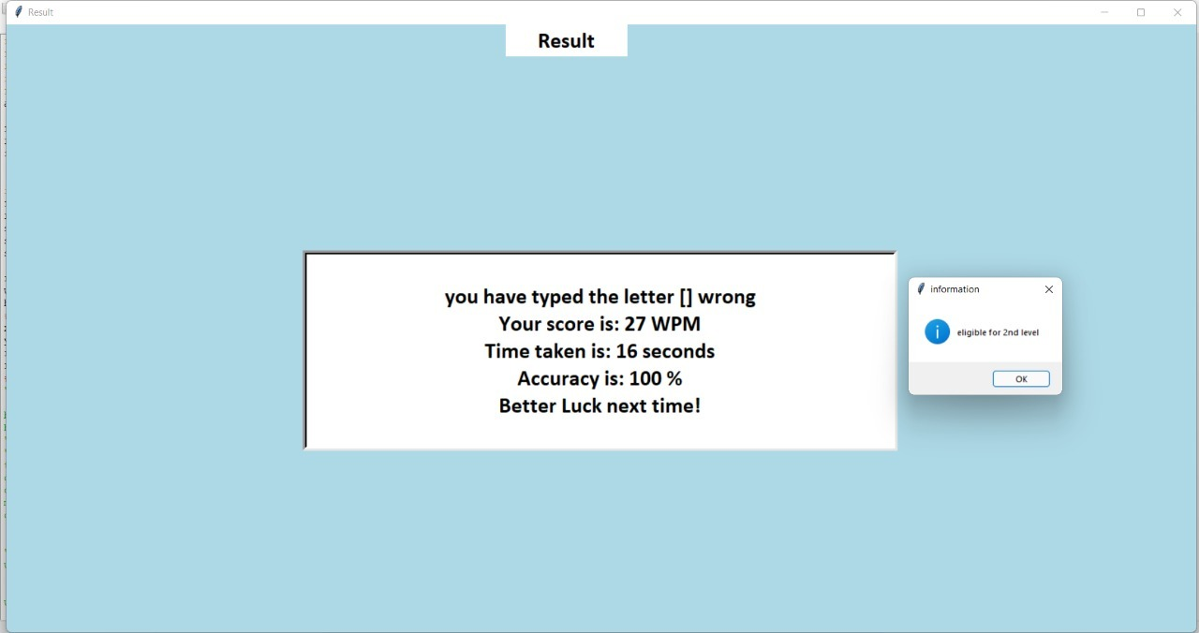
RESULTS&DISCUSSIONS(CONTD…)
LEVEL-1 RESULT
10

Slide 13
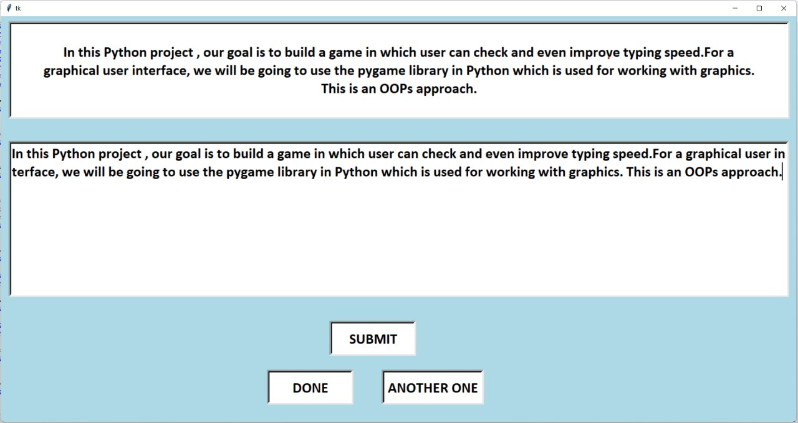
RESULTS&DISCUSSIONS(CONTD…)
LEVEL-2 WINDOW
10

Slide 14
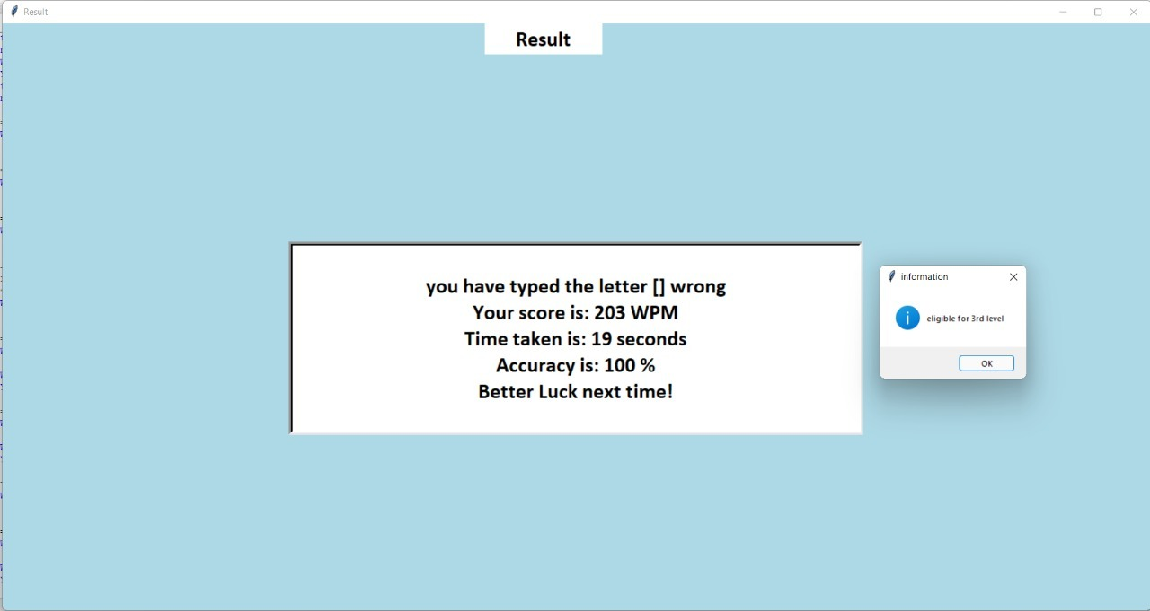
RESULTS&DISCUSSIONS(CONTD…)
LEVEL-2 RESULT
10

Slide 15
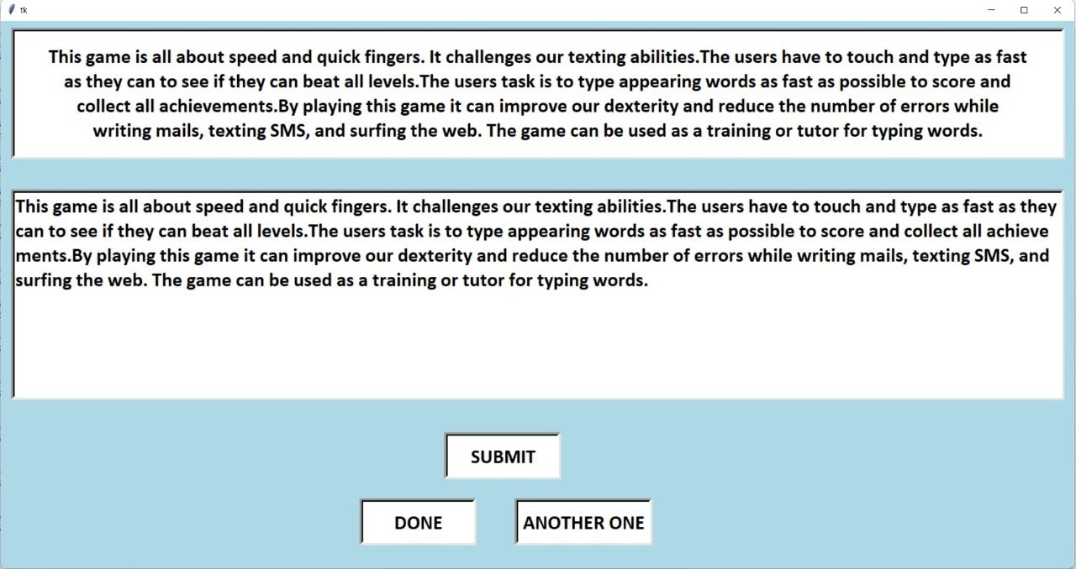
RESULTS&DISCUSSIONS(CONTD…)
LEVEL-3 WINDOW
10

Slide 16
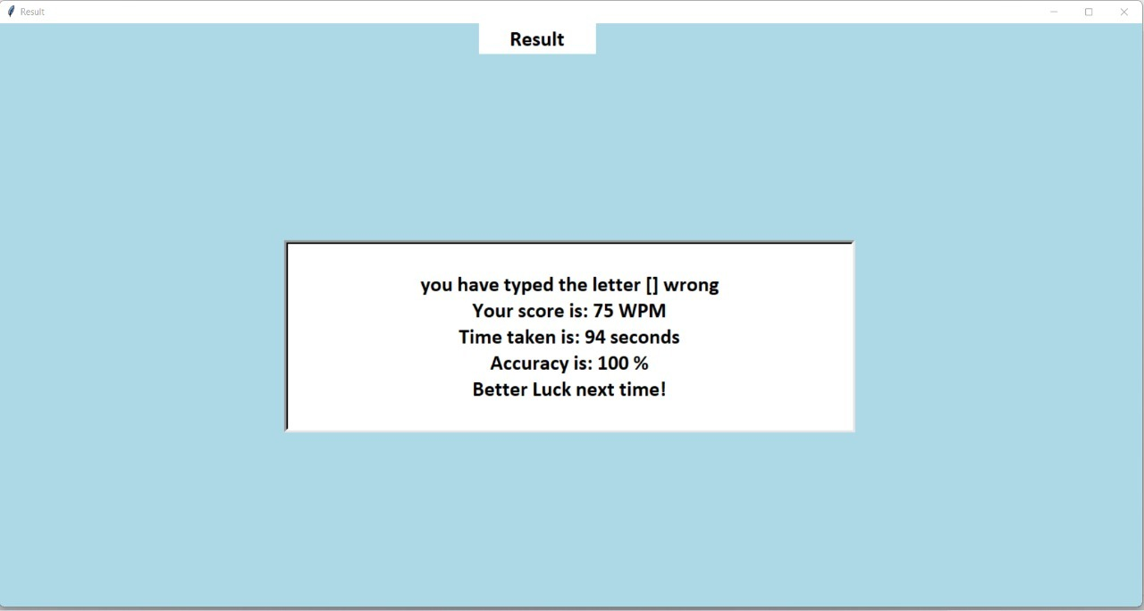
RESULTS&DISCUSSIONS(CONTD…)
LEVEL-3 RESULT
10

Slide 17
SUMMARY
This game is all about speed and quick fingers.
It challenges our texting abilities. The users have to touch and type as fast as they can to see if they can beat all levels.
The users task is to type appearing words as fast as possible to score and collect all achievements.
By playing this game it can improve our dexterity and reduce the number of errors while writing mails, texting SMS, and surfing the web.
The game can be used as a training or tutor for typing words. It’s a training game that should be real fun.
The users texting speed and accuracy improves while playing and practicing.
11

Slide 18

FUTURE SCOPE
This project can be extended to the following features:
Setting up a timer and the user the need to finish the given task within given specific time
Adding up more levels
Giving badges to the users who scores well
Setting up a virtual keyboard
12

Slide 19
REFERENCES
[1] https://www.geeksforgeeks.org/how-to-test-tvping-speed-using-pvthon
[2] https://voutu.be/FrkmBY4z66k
[3] https://voutu.be/HXPuK2SrvWA
[4] https://pvthonprogramming.altervista.org/create-more-windows-with-tkinter/
13

Slide 20


